Slide 1
Víz-kőzet-gáz kölcsönhatások kutatási lehetőségei az SZTFH-ban
Cseresznyés Dóra, Ph.D.
Geológiai Szolgálat, Szabályozott Tevékenységek Felügyeleti Hatósága
doracs@staff.elte.hu

Slide 2
Introduction
In the age of energy transition:
CO₂ geological storage is a promising way to reduce greenhouse gas emissions,
H₂ geological storage can be a solution to balance the intermittency of renewable energy resources.
Low-carbon H₂ can be efficiently produced from natural gas where emissions have been captured by CCS (Carbon Capture and Storage).
Possibilities in the Pannonian Basin

Slide 3
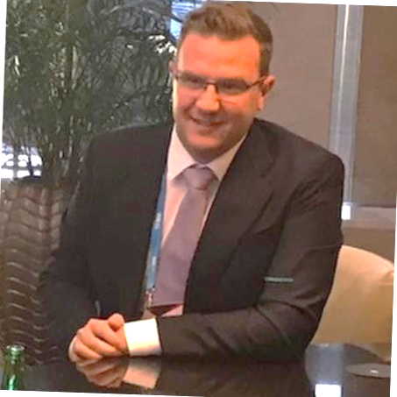
Subsurface CO₂ and H₂ storage team
Young researchers
Laura Horváth
Senior researchers
Dóra Cseresznyés
Orsolya Gelencsér
Ákos Kővágó
György Czuppon
Ágnes Szamosfalvi
Csilla Király
György Falus
Csaba Szabó
Zsuzsanna Szabó-Krausz
Dániel Breitner
Main question:
What processes can take place in the pore space during a storage project (CO₂, H₂)?

Slide 4
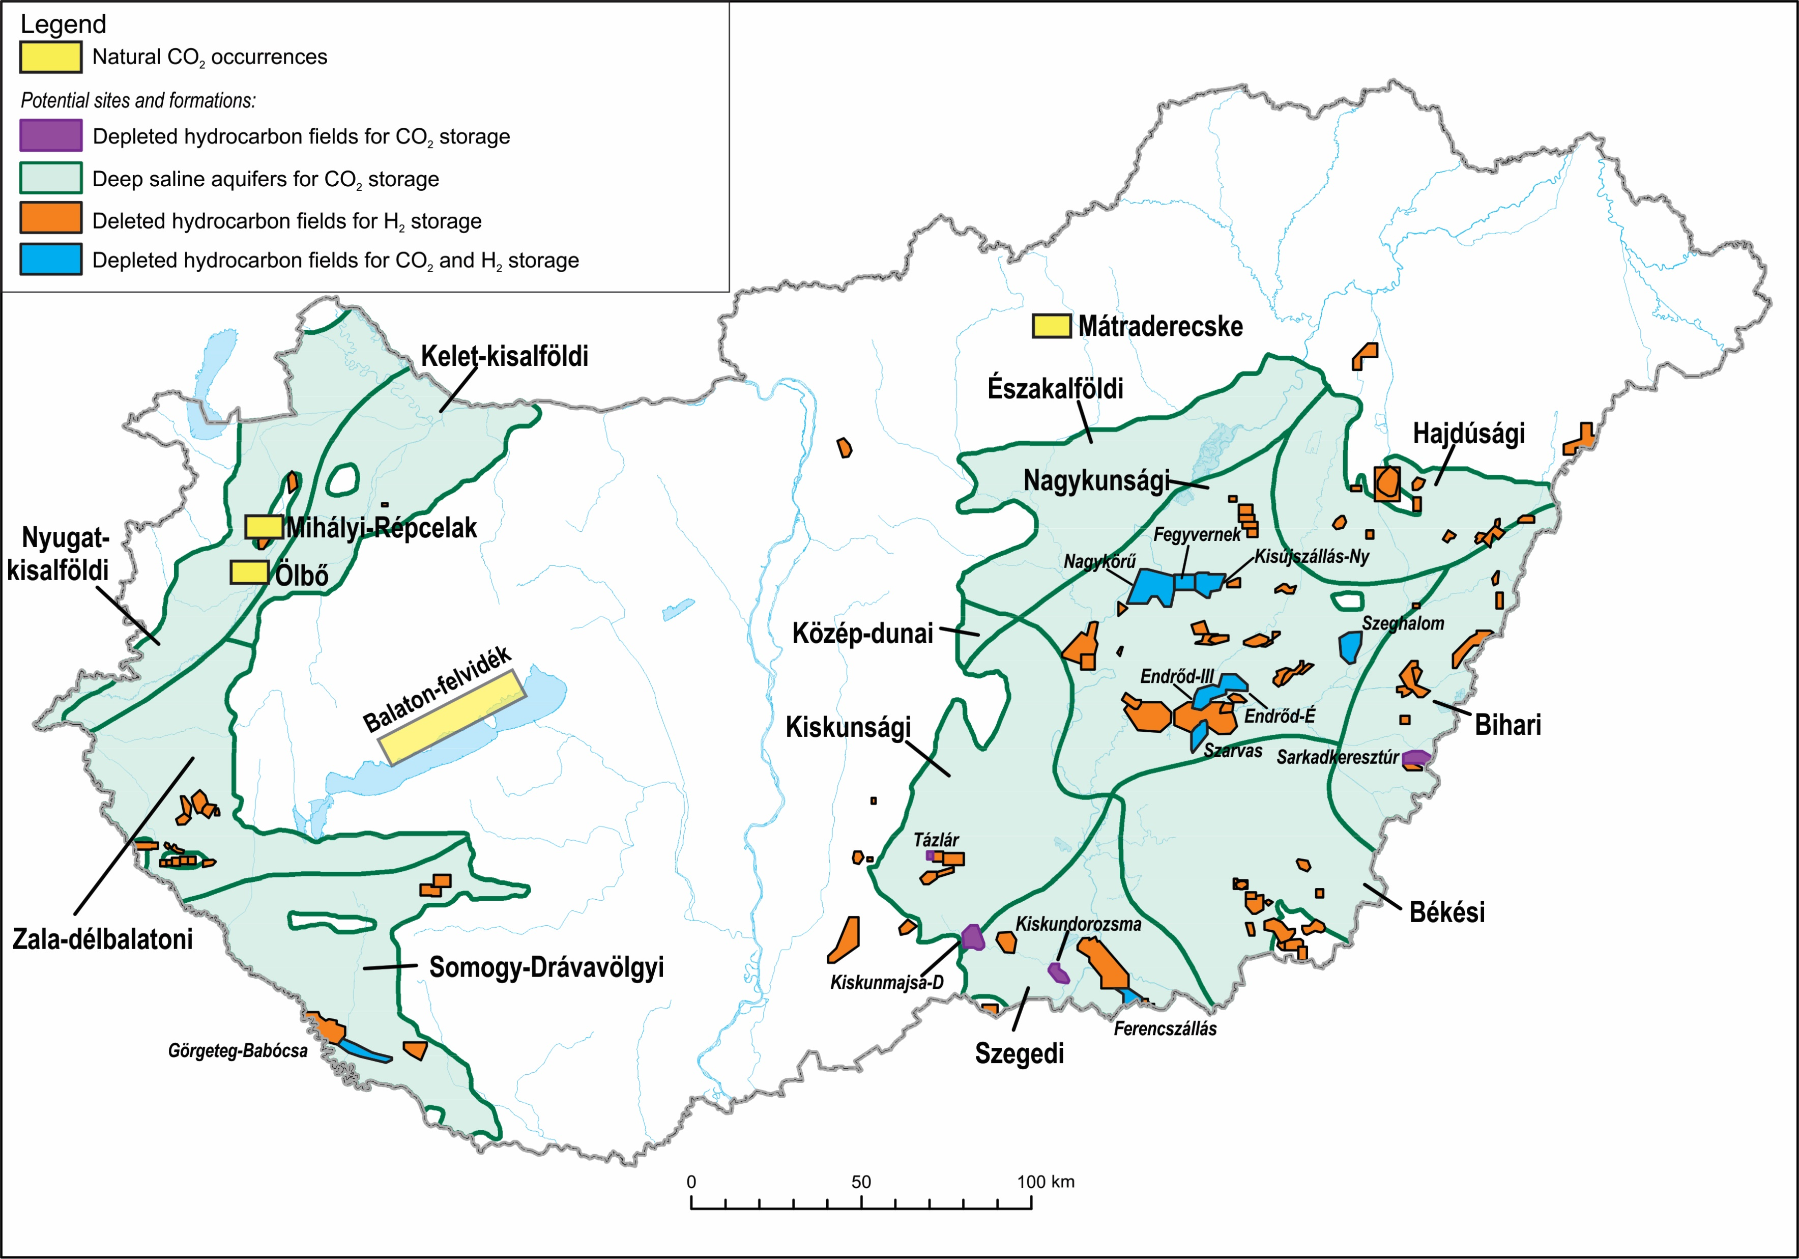
Storage potential in the Pannonian Basin
The Pannonian Basin was filled up by Neogene sediments
Porous rocks (e.g. sandstones) have great storage potential and have regional extent in the Pannonian Basin
The mechanisms of storage and the effect of the CO₂ or H₂ on porous media are not clear.
natural reservoirs
laboratory experiments
geochemical modelling with PHREEQC
Magyar et al. (2013)
4

Slide 5
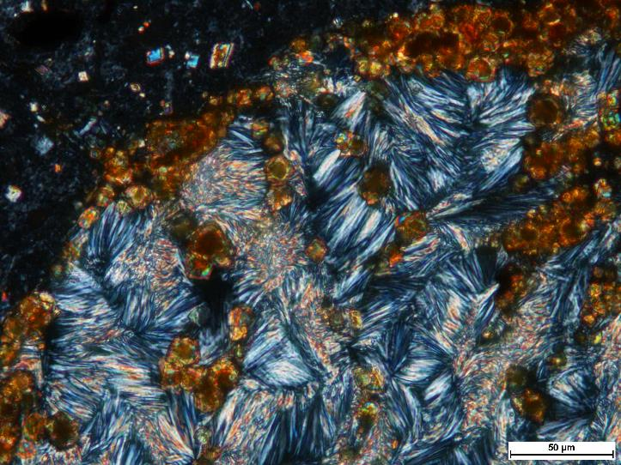
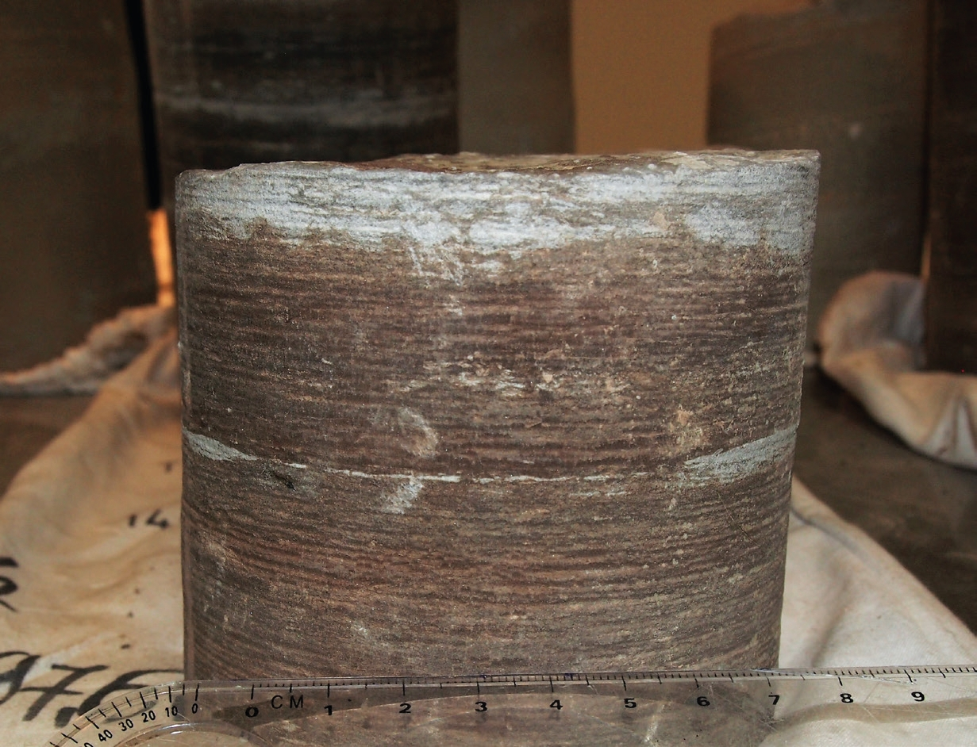
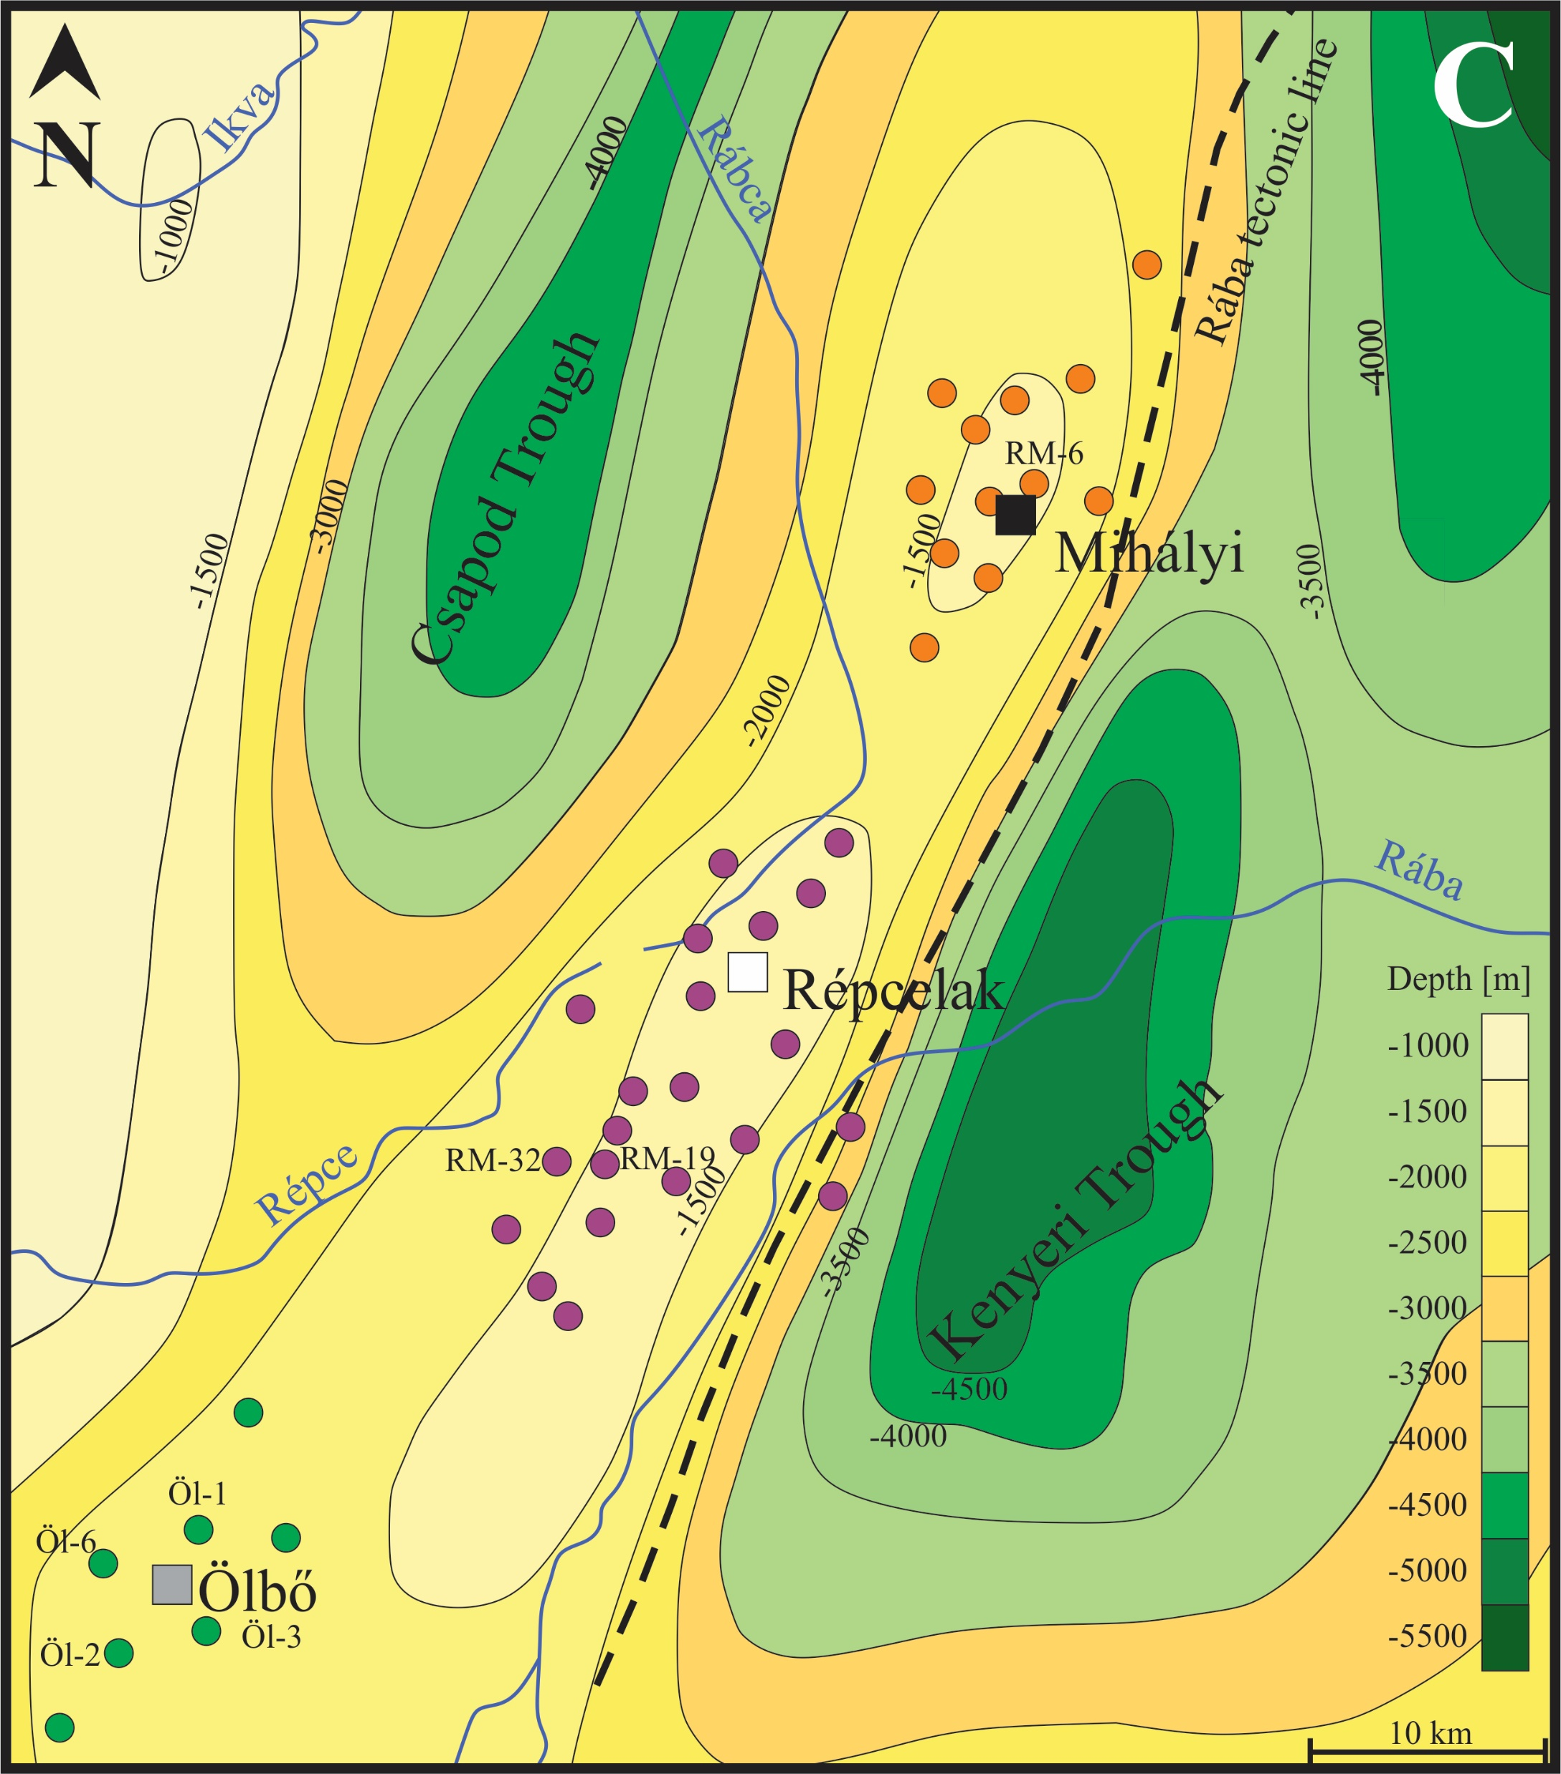
What we do?
Field trip
Collecting the core samples
Geochemical analysis of the rock samples
Daw
Microscopic image of a sample
Christmas tree at Répcelak
Cseresznyés et al. (2018)
Core sample
SEM image of a sample
Gas and water sampling in the field
Stable isotope analysis of water and carbonates
Geochamical modeling
Laboratory experiments
Natural CO₂ occurrences

Slide 6
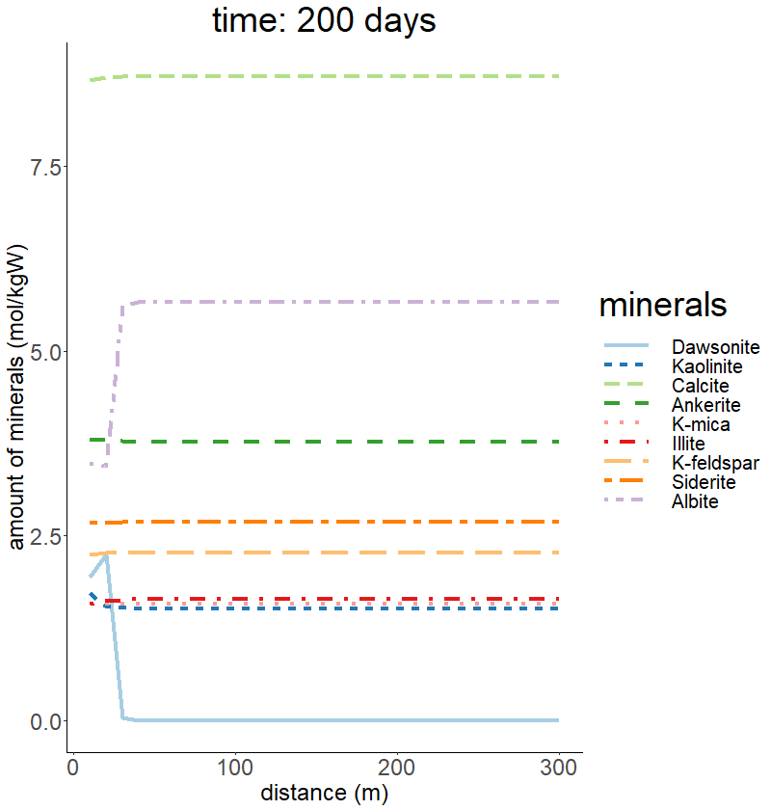
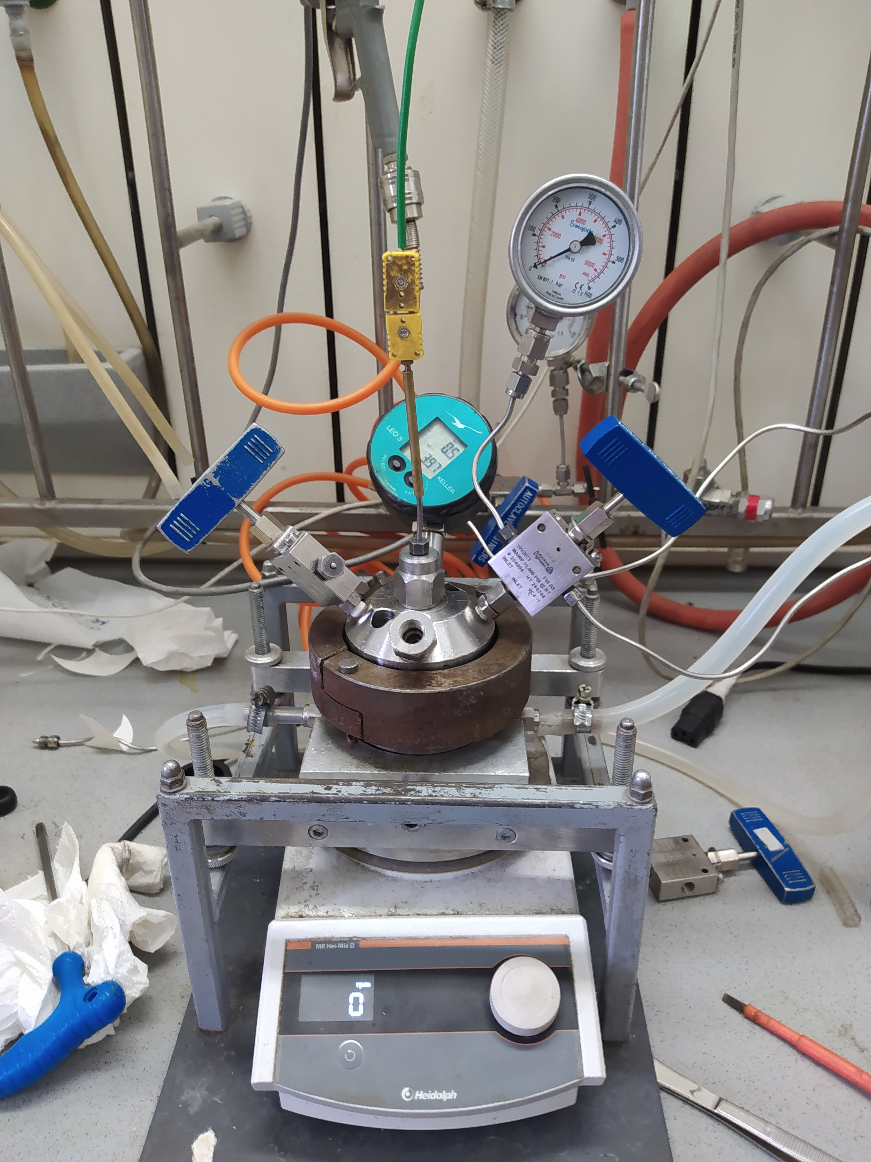
Research topics
Extend the possible subsurface storage reservoirs in the Pannonian Basin.
The mechanisms and the effect of CO₂ and H₂ are not well known during the storage on both, human an geological time scale.
Methodology: measurements, laboratory experiments and geochemical modeling
CO₂ subsurface storage
Underground Hydrogen storage
Contact us: doracs@staff.elte.hu
ELTE LRG (-1 Floor, Department of Petrology and Geochemistry)

